Slide 1
Week Two

Slide 2
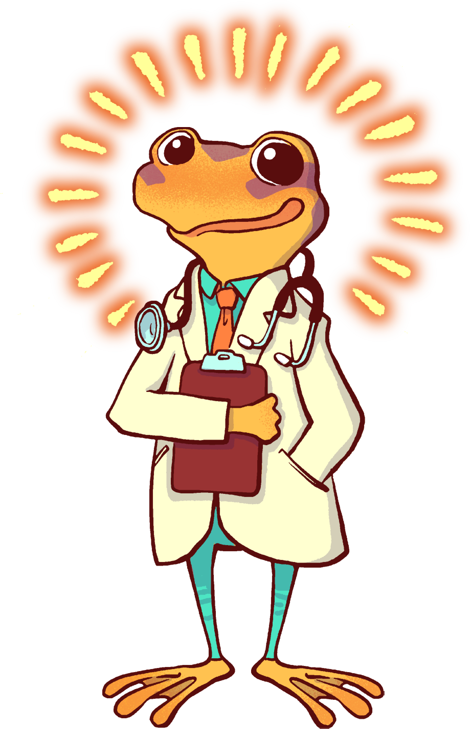
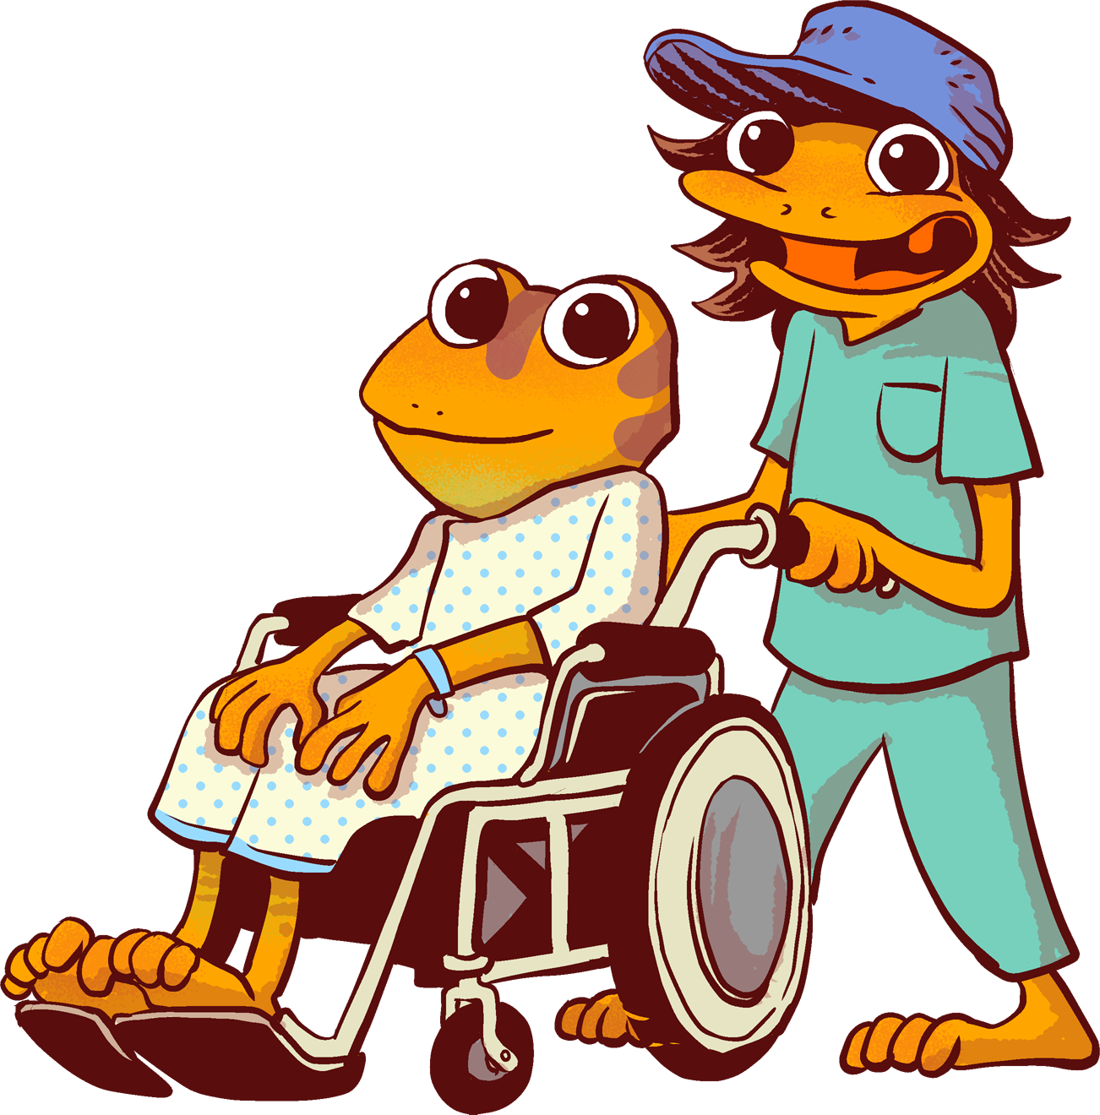
The Orange Frog
Gratitudes
Week 2
Scanning
By Shawn Achor

Slide 3
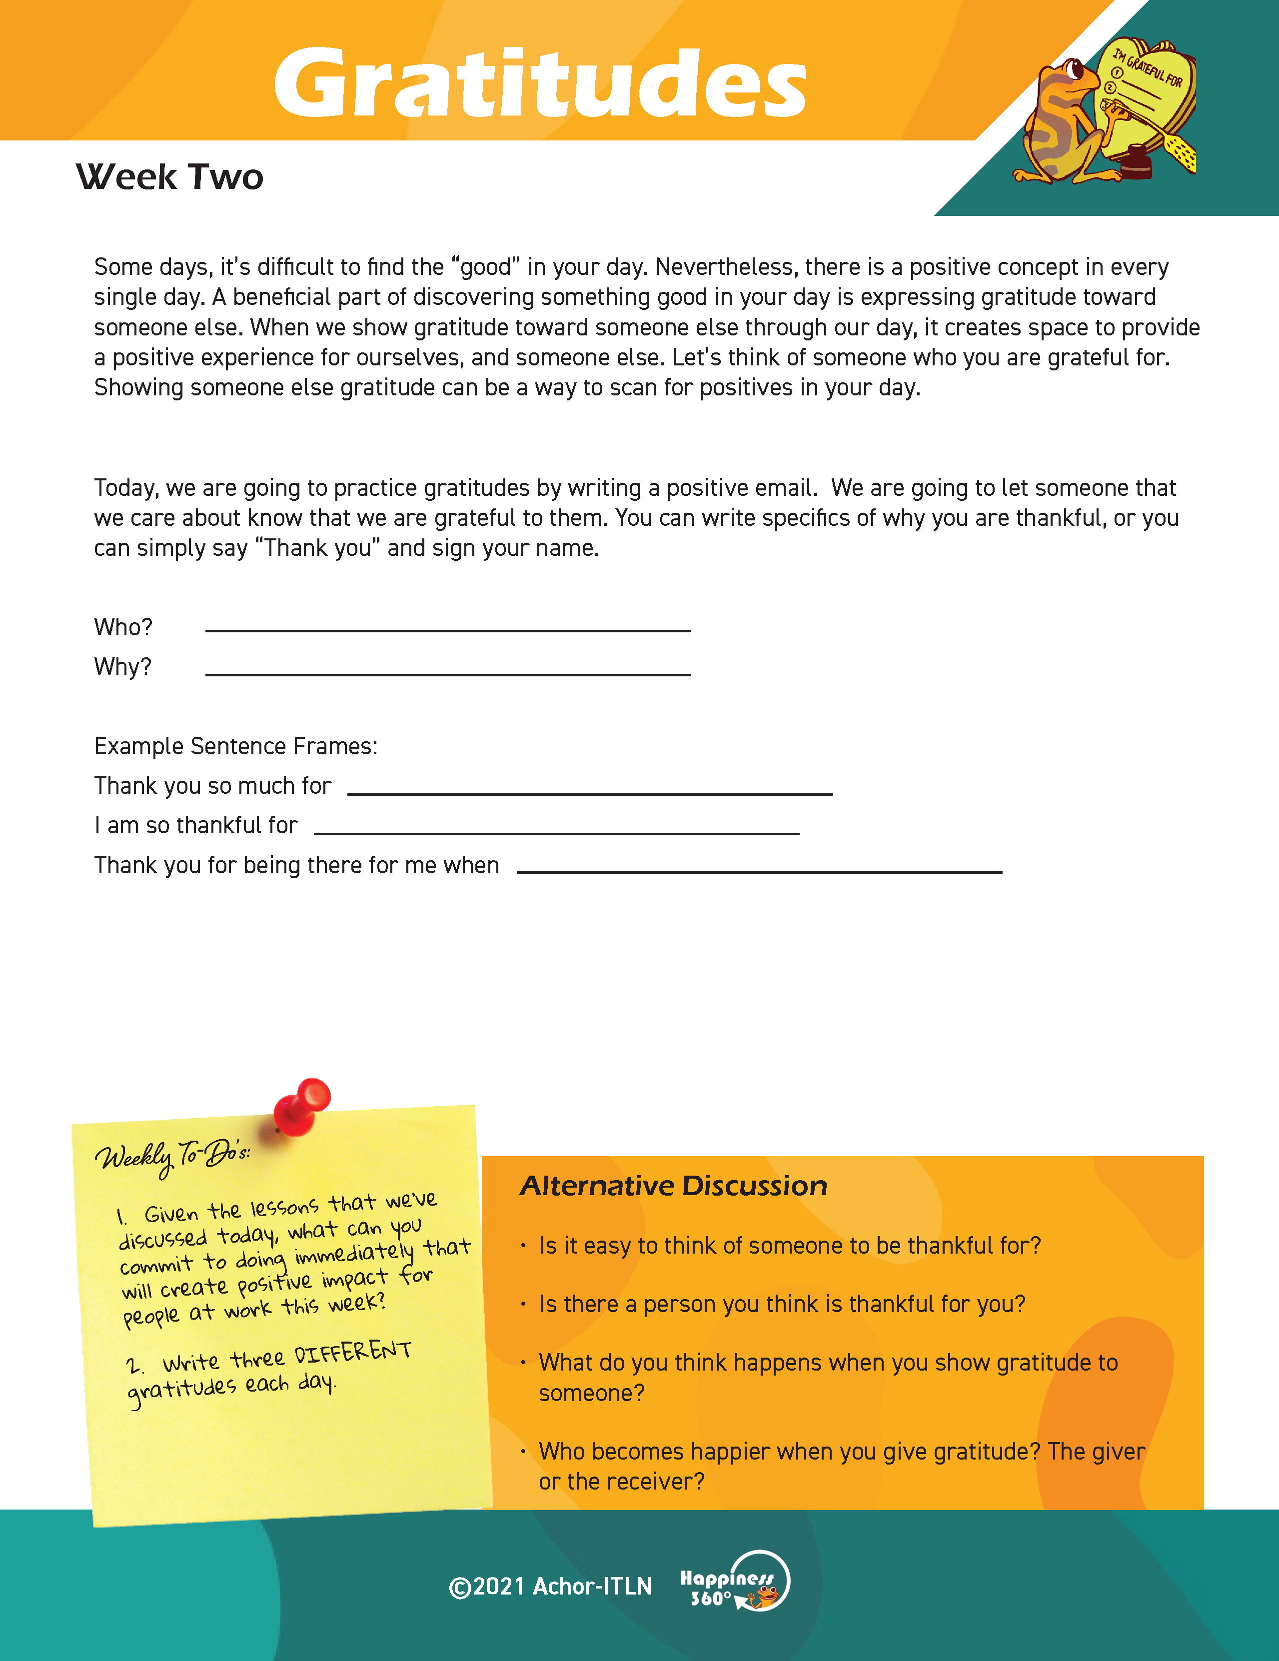
Each week, you’ll find a Worksheet in the resources section of the website and your Gratitude Journal.
Please, have those available.
\

Slide 4
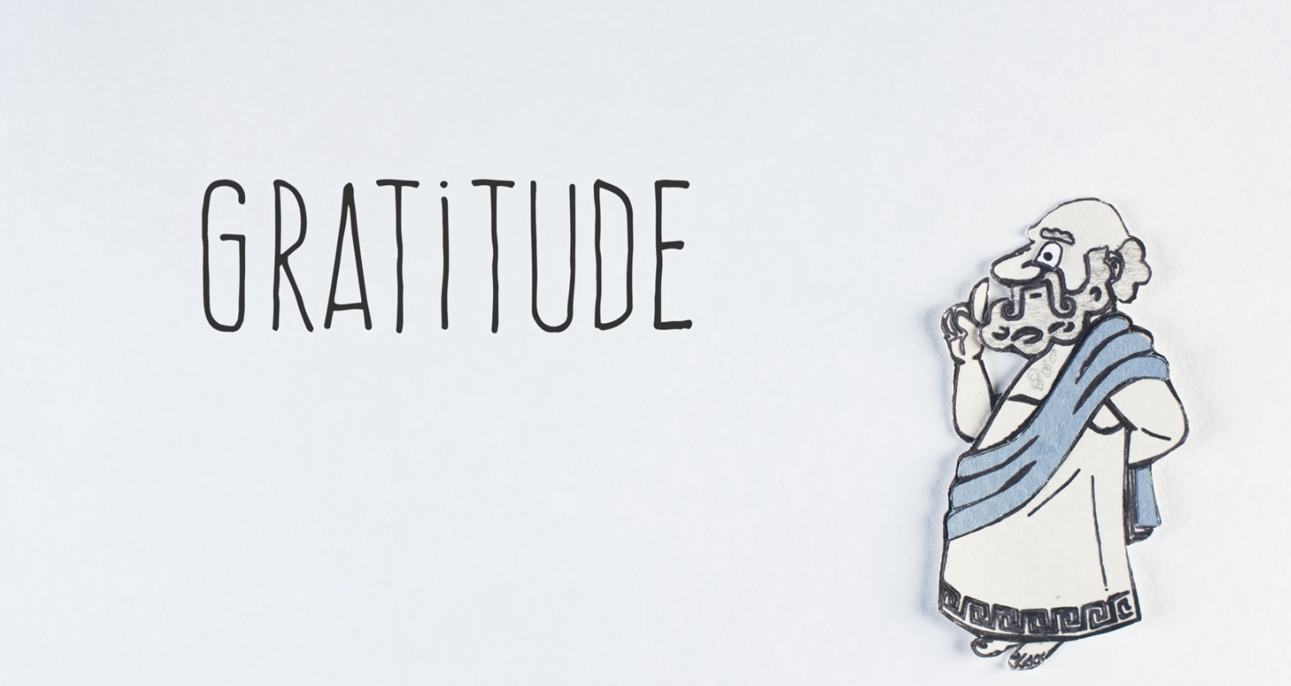
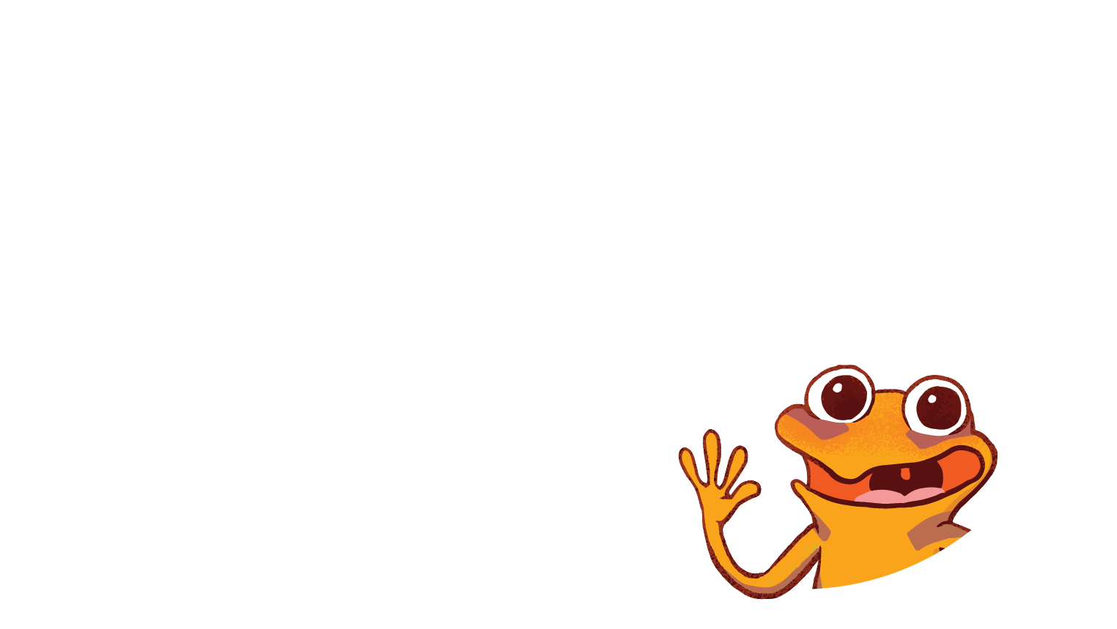
Did you get a chance to watch the BrainCraft video on some of the brain science relating to gratitude?
Prework
Expectations
Notes:
(Send this link out in advance.) Watch this video from the folks at BrainCraft. https://youtu.be/_sokh9e2WGc

Slide 5
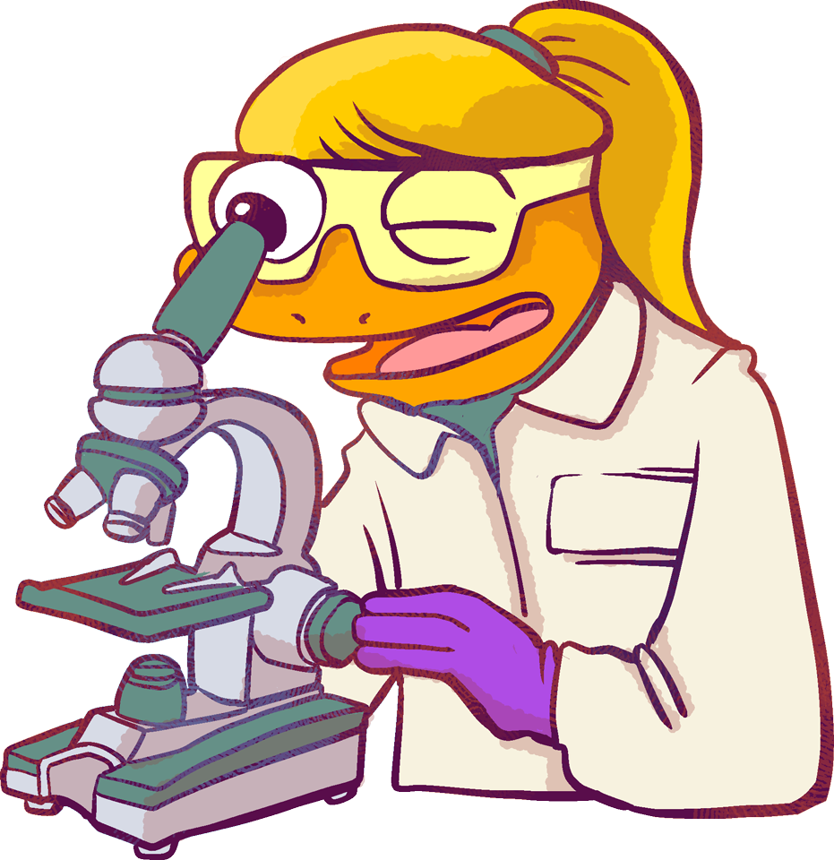
Gratitudes
Learning Objective: (“Each participant…”)
Can scan my day for someone I am grateful for.
Will discuss the connection between scanning my day for positives and finding someone to be thankful for.
Notes:
Standard:
Essential Concept and/or Skill: Communicate and work productively with others emphasizing collaboration and cultural awareness to produce quality work.
Interact positively as a team member.
Cooperate with others in a group setting.
Generate ideas with group members.
Are active listeners.
Read and understand information in a variety of forms.
Express ideas.
Skill:
Active listening, express ideas

Slide 6
Essential Concept
Demonstrate leadership, integrity, ethical behavior, and social responsibility in all environments.

Slide 7
Skills Required
Self-management & Self-awareness

Slide 8
Is it easy to find good things in your day?
Or
Does it take long to scan through your day and think of three things to be thankful for?

Slide 9
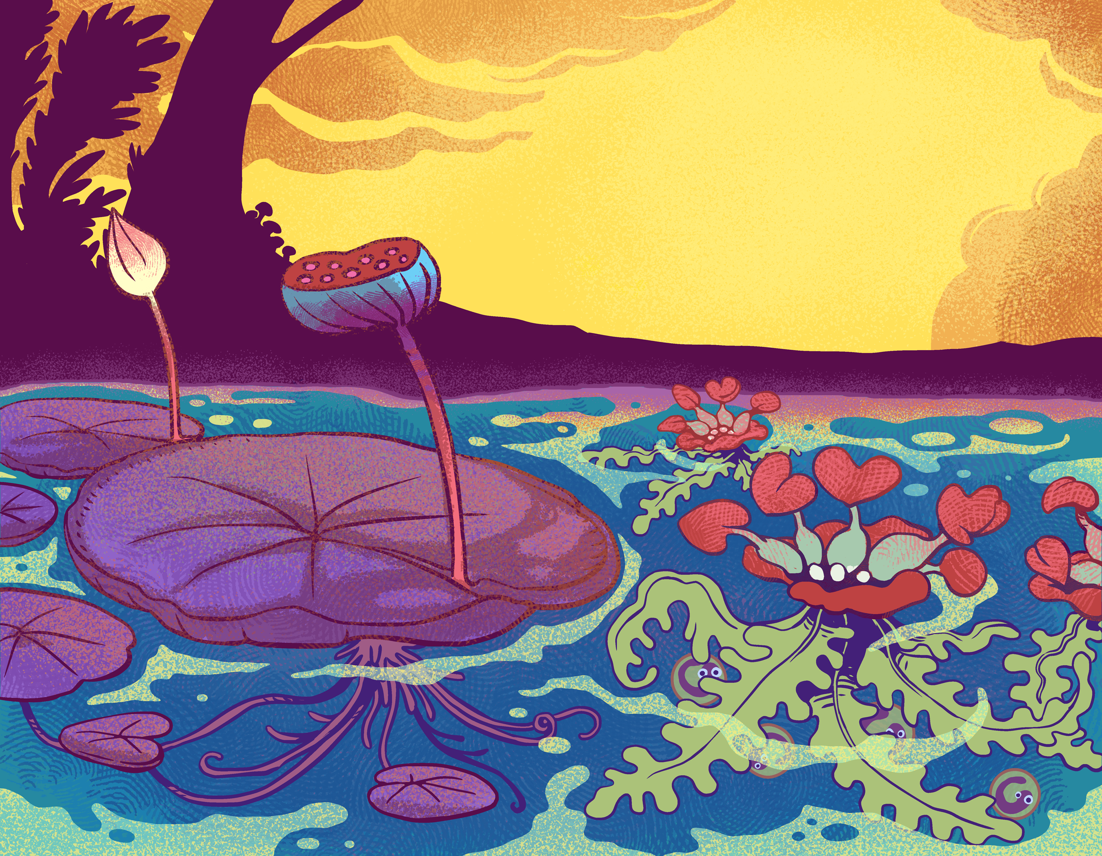
Scanning for Gratitudes
Somedays, it’s difficult to find the “good” in your day.
Nevertheless, there is a positive concept in every single day.
A beneficial part of discovering something good in your day is expressing gratitude toward someone else.
When we show gratitude toward someone else through our day, it creates space to provide a positive experience for ourselves, and someone else.
Notes:
Let’s think of someone who you are grateful for. Showing someone else gratitude can be a way to scan for positives in your day.

Slide 10
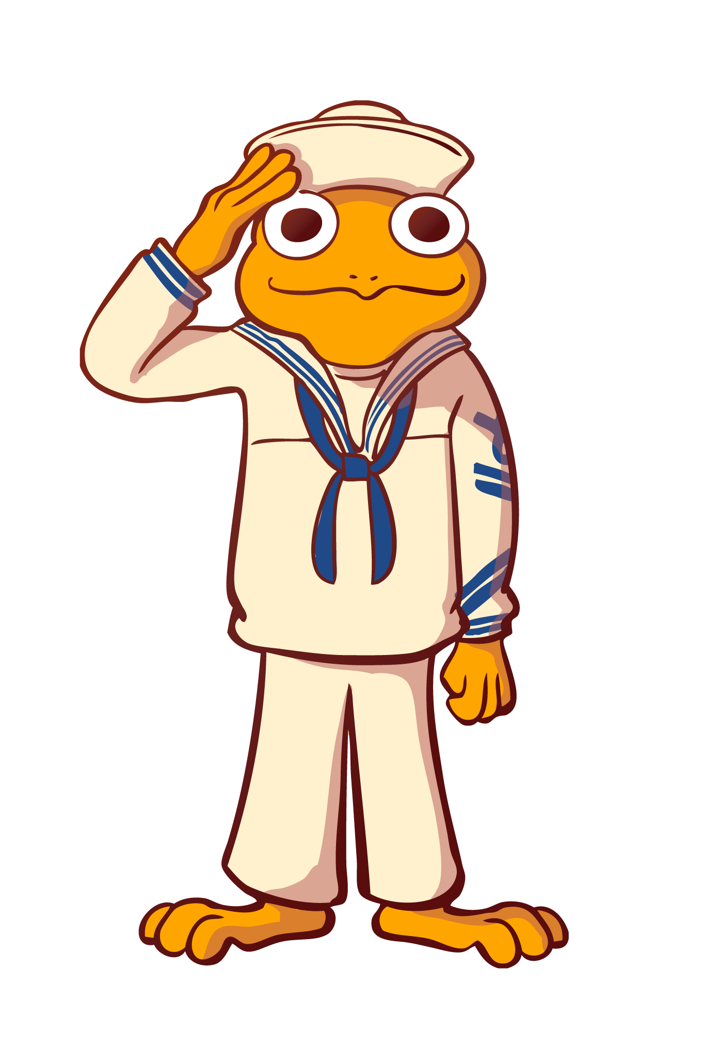
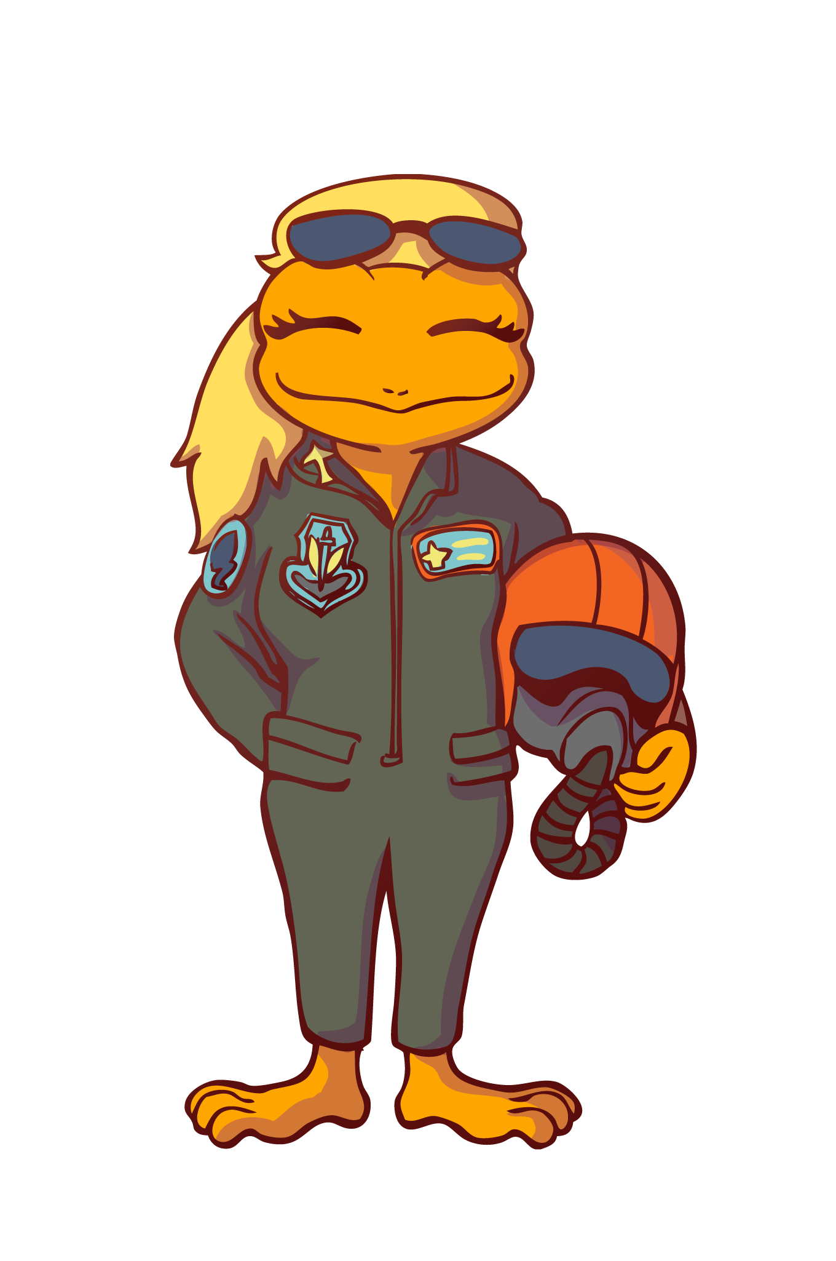
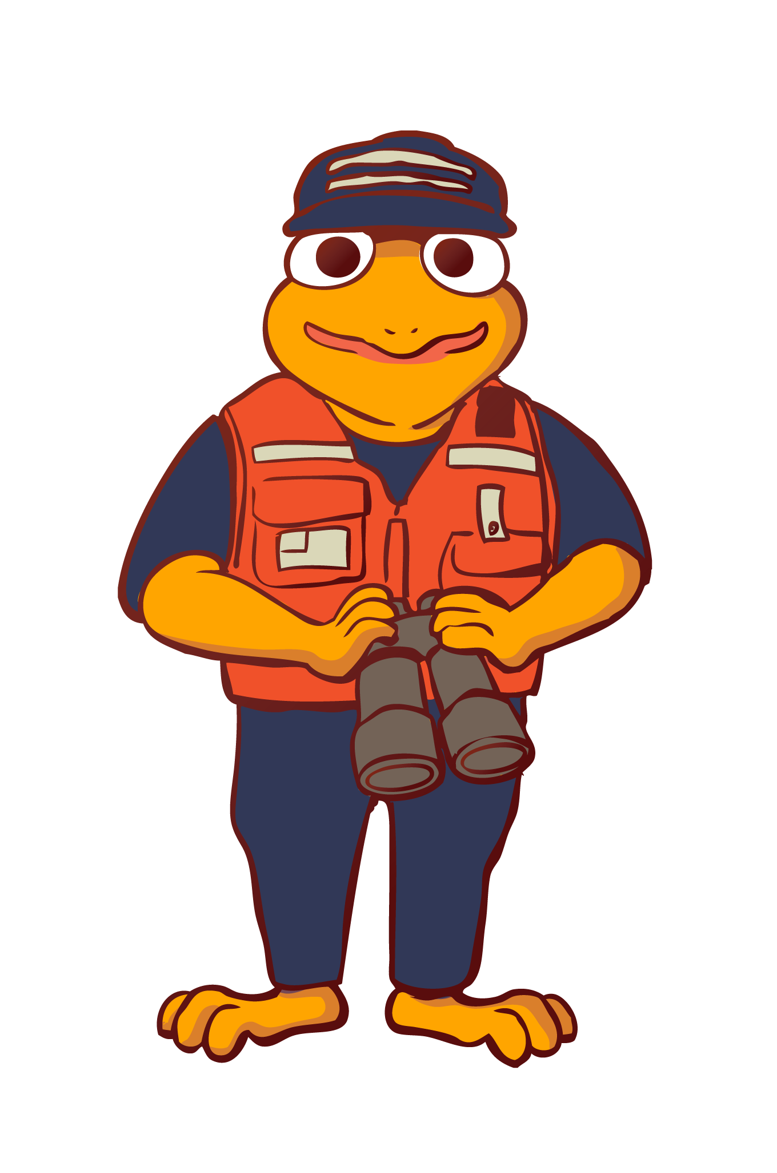
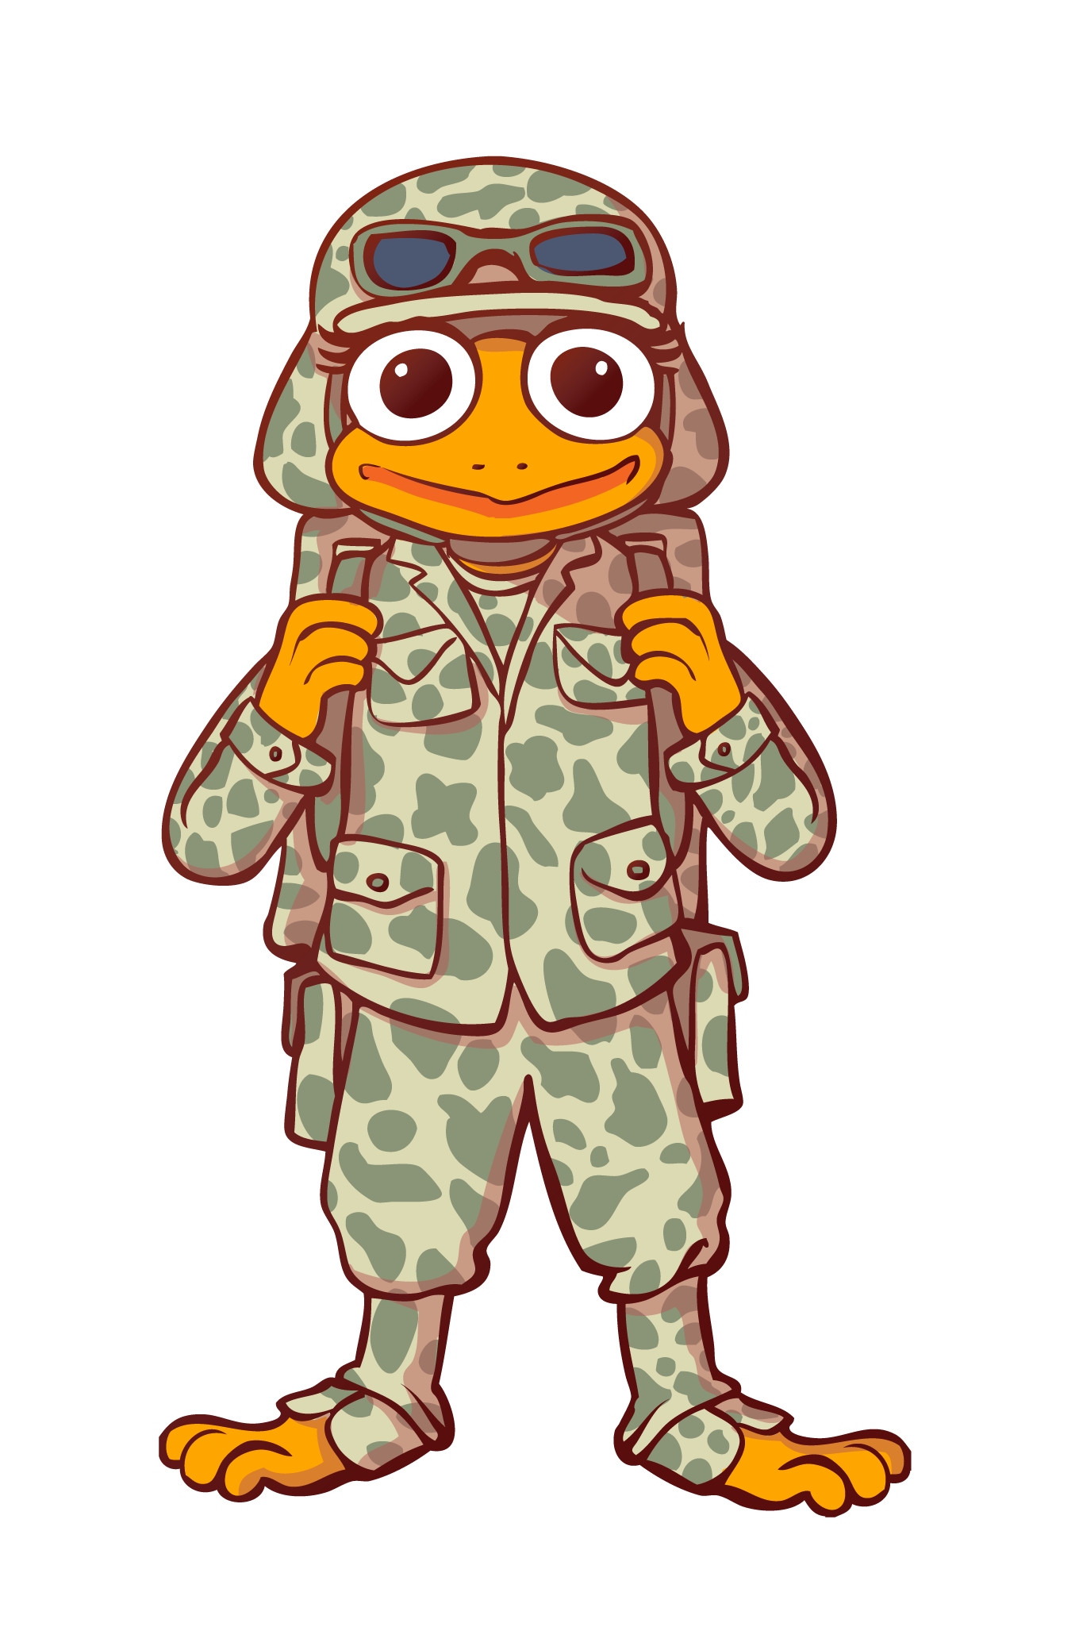
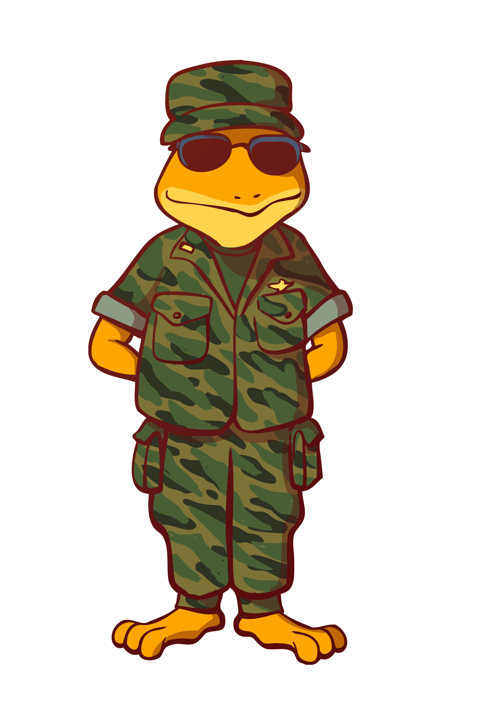
More Thought on Scanning
Let’s think of someone who you are grateful for...
Showing someone else gratitude can be a way to scan for positives in your day.

Slide 11
Connecting this Lesson to Our Work
How can scanning for something good in your day, either at home or at work, lead to being grateful towards others?
How can the inverse work? Can scanning for people to be grateful for at work lead to finding positive aspects of your work life?

Slide 12
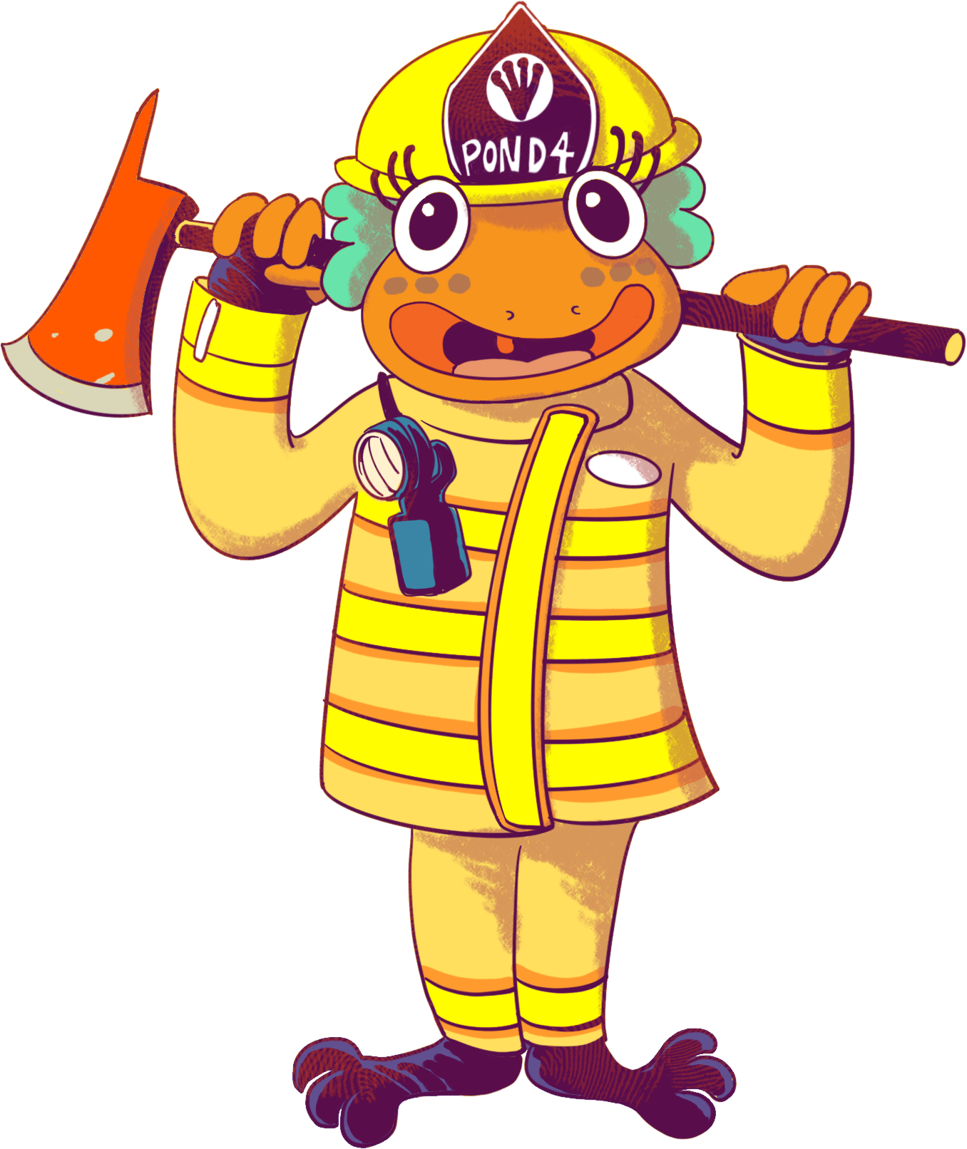
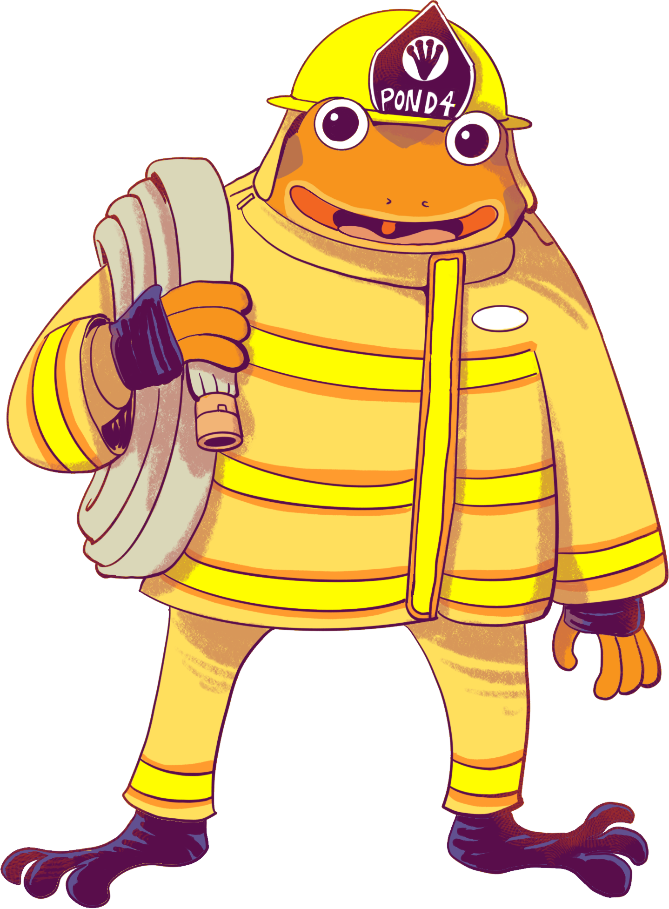
Action
Today, we are going to practice Gratitudes by writing a positive email.
We are going to let someone that we care about know that we are grateful to them.
It’s always best to be specific and provide some detail as to why you are grateful for them.
Notes:
Today, we are going to practice our gratitudes by writing a positive email. We are going to let someone that we care about know that we are grateful for them. Much like creating a gratitude list from our last lesson, it’s always best to be specific about why you are grateful. Put some detail into it and make the target of your grateful email someone who doesn’t necessarily expect to hear from you. These two tips can create a bigger impact for you and the receiver.

Slide 13
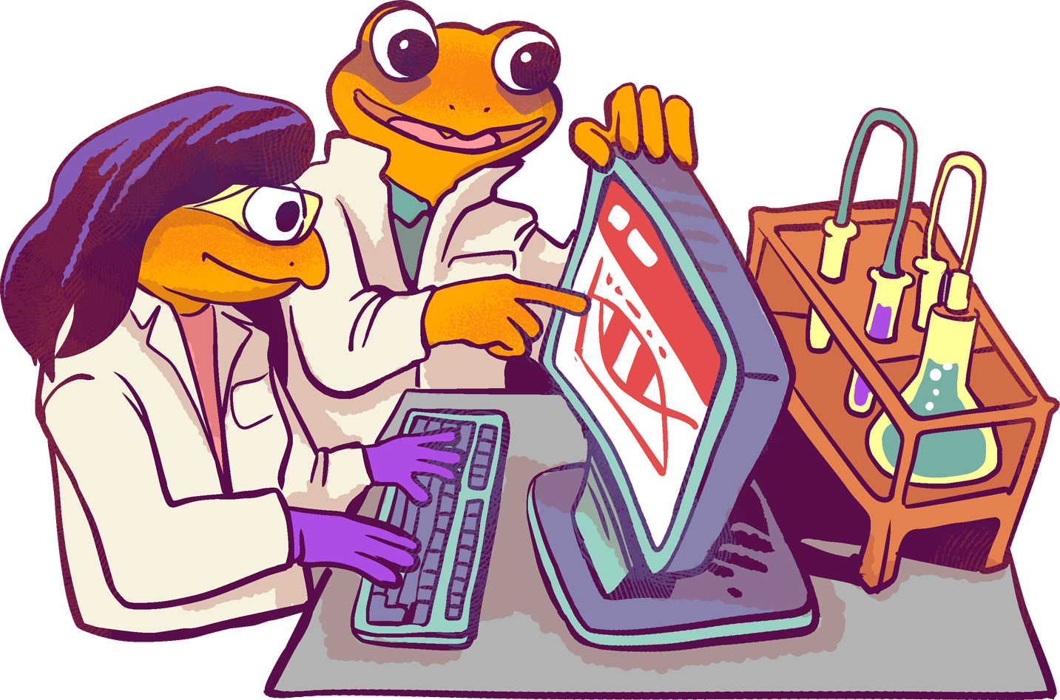
Bonus Questions
Is it easy to think of someone to be thankful for?
Is there a person you think is thankful for you?
What do you think happens when you show gratitude to someone?
Who becomes happier when you give gratitude? The giver or the receiver?

Slide 14
Weekly To-Dos
Continue with your 21-day Gratitude challenge.
Make sure to use the Gratitude Journal to track your progress.

